Slide 1
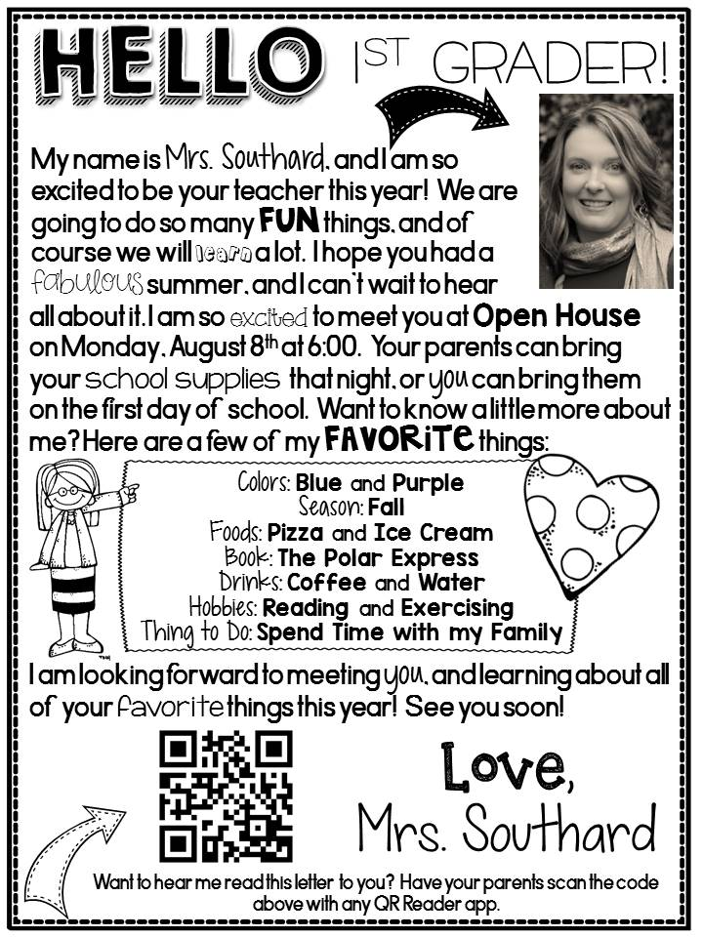

Slide 2
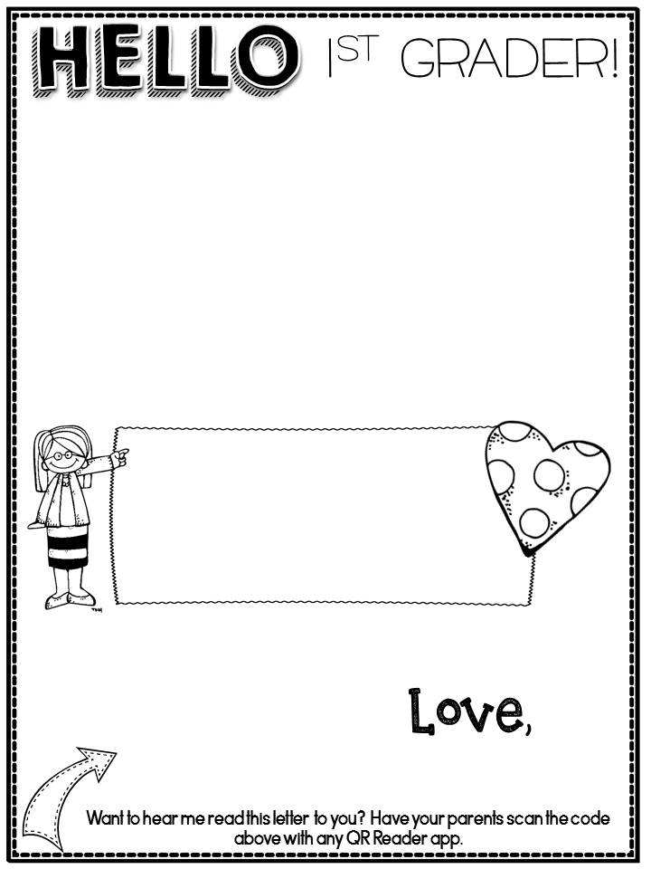
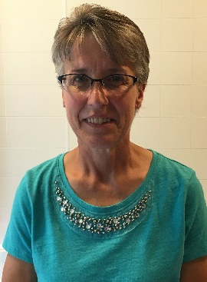
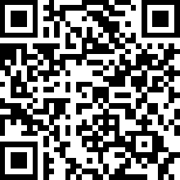
My name is Mrs. Elser, and I am so HAPPY to be your teacher this year! We are going
to do so many FUN things, and of course we
will learn A lot. I hope you had an AMAZING
summer! I can’t wait to hear all about it.
I am so EXCITED to meet you and your parents! I hope you are able to come to Open House on Thursday, August 23rd from 5:00-7:00 in Room #208. You can bring your school supplies that night or you can bring them on the first day of school. Do you want to know a little about me? Here are a few of my FAVORITE things:
Colors: Red and light blue
Foods: lasagna and ice cream
Season: fall
Book: Charlotte’s Web
Things to do: Spending time with my family and friends, spending time outdoors and at the beach, golfing, baking and reading
I am looking forward to meeting you and learning about all of YOUR FAVORITE things this year! See you soon!
Mrs. Elser

Slide 3
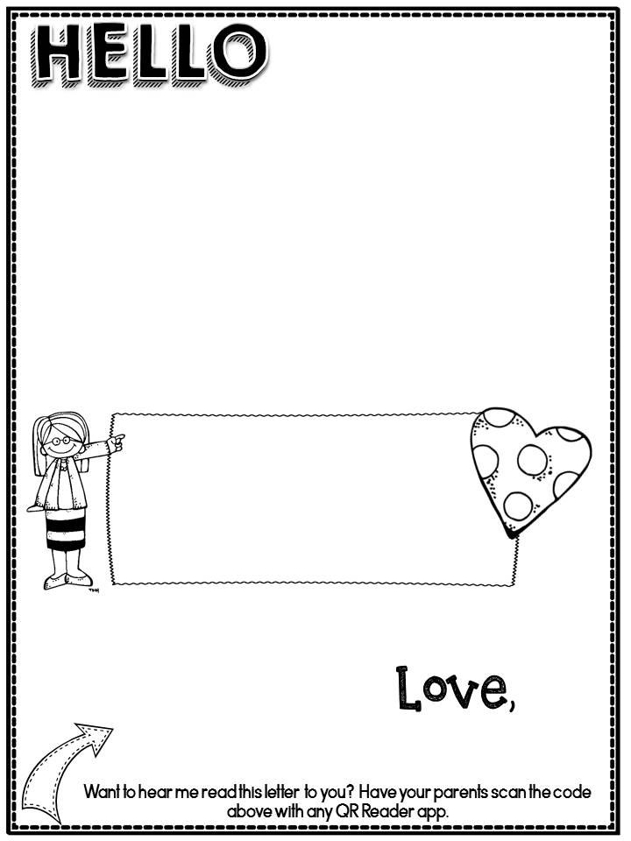
You can type your letter by clicking in this text box.
This is where I typed about my favorite things.
You can add more to your letter here, or just delete this text box.
Type your name here.

